Slide 1
IMAGE STEGANOGRAPHY USING LEAST SIGNIFICANT BIT
MINOR PROJECT PRESENTATION
SEMESTER III (2019-2020)
SUBMITTED TO
Prof. Sunil Kumar Muttoo
SUBMITTED BY
Kulpreet Kour (1893904)
Moni Tripathi (1893908)

Slide 2
CONTENTS
INTRODUCTION
STEGANOGRAPHY
TYPES OF STEGANOGRAPHY
IMAGE STEGANOGRAPHY
LSB ALGORITHM
IMPLEMENTATION
CONCLUSION
REFERENCES

Slide 3
INTRODUCTION
Steganography is an art of hiding information inside information.
The main objective of Steganography is mainly concerned with the protection of contents of the hidden information. Images are ideal for information hiding because of the large amount of redundant space is created in the storing of images.
Steganography is the technique of hiding secret data within an ordinary, non-secret, file or message in order to avoid detection; the secret data is then extracted at its destination. The use of steganography can be combined with encryption as an extra step for hiding or protecting data.
Definition: It is an art and science of hiding information by embedding it in some other data
Steganography literally means “covered writing”
Goals : To hide a secret message within an object.

Slide 4
STEGANOGRAPHY VS CRYPTOGRAPHY
The meaning of the steganography is “covered or hidden writing” while cryptography signifies “secret writing”
Steganography is an attempt to achieve secure and undetectable communication. On the other hand, cryptography intends to make the message readable for only the target recipient but not by others through obtaining a disguised form of message.
In steganography, the main structure of the message is not changed whereas cryptography imposes a change on the secret message before transferring it over the network.
The cryptography is prevalently used unlike steganography, which is not so familiar.

Slide 5
The degree of the security of the secret data is measured by the key length which makes the algorithm strong and unbreakable. Conversely, there is no such thing in steganography. Steganography provides only confidentiality and authentication. On the contrary, the principles of security provided by the cryptography are confidentiality, integrity, authentication, and non-repudiation. Spacial domain, transform domain embedding and model-based are some of the algorithms used in steganography. In contrast, the cryptography uses techniques named as transpositional, substitution, stream and block ciphers. The steganography can be employed on any medium such as text, audio, video and image while cryptography is implemented only on the text file. The reverse engineering employed to decode the message in cryptography is known as cryptanalysis. As against, the technique used to detect the presence of the steganography is known as steganalysis.

Slide 6
TYPES OF STEGANOGRAPHY
There are four type of steganography
Text steganography
Image steganography
Audio steganography
Video Steganography

Slide 7
Text steganography: Text steganography can be achieved by altering the text formatting, or by altering certain characteristics of textual elements (e.g.characters).
Text Steganography Techniques:
a) Selective hiding: This hides the characters in the first (or any specific location) characters of the words. Concatenating those characters help extracting the text. But this technique requires huge amount of plain text.
b) HTML web pages: This may hide text using the fact that attributes of HTML tags are case insensitive. Those characters can then be used to retrieve the original text.
c) Hiding using Whitespace: Fewer numbers of whitespaces may specify a 0 and more number of whitespaces between words may determine a 1.
d) Semantic Hiding: Uses synonyms to hide the message

Slide 8
Image steganography:
Images are used as the message carriers. Images are the most popular cover objects used for steganography.
Audio steganography:
In audio steganography, secret message is embedded into digitized audio signal which result slight altering of binary sequence of the corresponding audio file.
Video Steganography:
Video Steganography is a technique to hide any kind of files or information into digital video format. Video (combination of pictures) is used as carrier for hidden information.

Slide 9
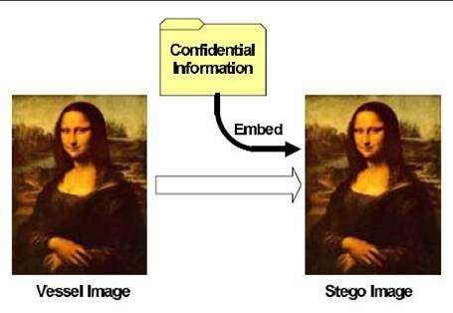
IMAGE STEGANOGRAPHY

Slide 10
Images are used as the message carriers.
Images are the most popular cover objects used for steganography.
Image Steganography refers to the process of hiding data within an image file. The image selected for this purpose is called the cover-image and the image obtained after steganography is called the stego-image.
Image Steganography requires following elements to carry out the work:
Cover medium:
It is an image that holds secret message.
The Secret message:
It is message to be transmitted. It can be plain or encrypted text, images or any other data.
The Stego-key:
It is key used to hide the message (May or may not be used).

Slide 11
How is it done?
An image is represented as an N*M (in case of greyscale images) or N*M*3 (in case of colour images) matrix in memory, with each entry representing the intensity value of a pixel. In image steganography, a message is embedded into an image by altering the values of some pixels, which are chosen by an encryption algorithm. The recipient of the image must be aware of the same algorithm in order to known which pixels he or she must select to extract the message.

Slide 12
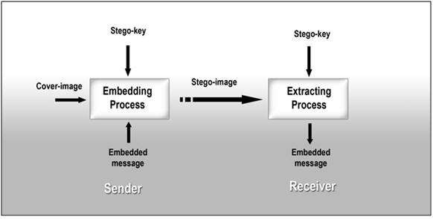

Slide 13
IMAGE STEGANOGRAPHY TECHNIQUES
By using LSB(Least Significant Bit algorithm)
Masking and Filtering
Algorithms and Transformation

Slide 14
Image Steganography using LSB algorithm
The most common and popular method of modern day steganography is to make use of LSB of picture’s pixel information
This technique works best when the file is longer than the message file and if image is gray scale.
When applying LSB techniques to each byte of a 24 bit image, three bits can be encoded into each pixel.
If the LSB of the pixel value of cover image C(I ,j) is equal to the message bit SM of secret massage to be embedded, C(i ,j) remain unchanged; if not, set the LSB of C(i, j) to SM.

Slide 15
message embedding Procedure is given below:
S(i,j) = C(i,j) - 1, if LSB(C(i,j)) = 1 and SM = 0
S(i,j) = C(i,j) + 1, if LSB(C(i,j)) = 0 and SM = 1
S(i,j) = C(i,j), if LSB(C(i,j)) = SM
Where LSB(C(i, j)) stands for the LSB of cover image C(i,j) and “SM” is the next message bit to be embedded. S(i,j) is the stego image.

Slide 16
Implementation
Tools
Language used: python
Platform used : Anaconda
IDE :Jupyter notebook
Packages used:
● Numpy
Math
● PIL
● Cv2
● Matplotlib
● Skimage

Slide 17
Data Embedding Algorithm
Step 1: Extract the pixels of the cover image.
Step 2: Extract the characters of the text .
Step 3: Extract the characters from the Stego key.
Step 4: Choose first pixel and place it in first component of pixel.
Step 5: Place some terminating symbol to indicate end of the key. 0 has been used as a terminating symbol in this algorithm.
Step 6: Insert characters of text in each component of next pixels by replacing it.
Step 7: Repeat step 6 till all the characters has been embedded.

Slide 18
Data Extraction Algorithm
Step 1: Extract the pixels of the stego image.
Step 2: Now, start from first pixel and extract stego key characters from first component of the pixels. Follow Step3 up to terminating symbol, otherwise follow step 4.
Step 4: If this extracted key matches with the key entered by the receiver, then follow Step 5, otherwise terminate the program.
Step 5: If the key is correct, then go to next pixels and extract secret message characters from first component of next pixels. Follow Step 5 till up to terminating symbol, otherwise follow step 6.
Step 6: Extract secret message.

Slide 19
Example
We can use images to hide things if we replace the last bit of every color’s byte with a bit from the message.
Message A 01000001
Image with 3 pixels
Pixel 1 : 11111000 11001001 00000011
Pixel 2 : 11111000 11001000 00000011
Pixel 3 : 11111000 11001001 00000011
Now we hide our message in the image.
Message: 01000001
Pixel 1 : 1 1 1 1 1 0 0 0 1 1 0 0 1 0 0 1 00000010
Pixel 2 : 1 1 1 1 1 0 0 0 1 1 0 0 1 0 0 0 00000010
Pixel 3 : 11111000 11001001 00000011

Slide 20
IMPLEMENTATION
STEGANOGRAPHY FOR COLORED IMAGE
We take colored image : flowers.jpg
# On red channel/green channel/blue channel
# libraries for importing image
from PIL import Image, ImageFont, ImageDraw
import textwrap
def decode_image(file_location="abc3.png"):
"""Decodes the hidden message in an image
file_location: the location of the image file to decode. By default is the provided encoded image in the images folder
"""
encoded_image = Image.open(file_location)
red_channel = encoded_image.split()[0]
x_size = encoded_image.size[0]
y_size = encoded_image.size[1]

Slide 21
decoded_image = Image.new("RGB", encoded_image.size)
pixels = decoded_image.load()
for i in range(x_size):
for j in range(y_size):
if( bin(red_channel.getpixel((i, j)))[-1] == '0':
pixels[i, j] = (255, 255, 255)
print(pixels[i, j])
else:
pixels[i, j] = (0,0,0)
green_channel = encoded_image.split()[1]
x_size = encoded_image.size[0]
y_size = encoded_image.size[1]
decoded_image = Image.new("RGB", encoded_image.size)
pixels = decoded_image.load()
for i in range(x_size):
for j in range(y_size):

Slide 22
if (bin(green_channel.getpixel((i, j)))[-1] == '0':
pixels[i, j] = (255, 255, 255)
print(pixels[i, j])
else:
pixels[i, j] = (0,0,0)
blue_channel = encoded_image.split()[2]
x_size = encoded_image.size[0]
y_size = encoded_image.size[1]
decoded_image = Image.new("RGB", encoded_image.size)
pixels = decoded_image.load()
for i in range(x_size):
for j in range(y_size):
if bin(blue_channel.getpixel((i, j)))[-1] == '0':
pixels[i, j] = (255, 255, 255)
print(pixels[i, j])
else:
pixels[i, j] = (0,0,0)
decoded_image.save("abc.png")

Slide 23
def write_text(text_to_write, image_size):
""“
Writes text to an RGB image. Automatically line wraps
text_to_write: the text to write to the image
"""
image_text = Image.new("RGB", image_size)
font = ImageFont.load_default().font
drawer = ImageDraw.Draw(image_text)
#Text wrapping. Change parameters for different text formatting
margin = offset = 10
for line in textwrap.wrap(text_to_write, width=60):
drawer.text((margin,offset), line, font=font)
offset += 10
return image_text

Slide 24
def encode_image(text_to_encode, template_image="flowers.jpg")
""“
Encodes a text message into an image
text_to_encode: the text to encode into the template image
template_image: the image to use for encoding. An image is provided by default.
"""
template_image = Image.open(template_image)
red_template = template_image.split()[0]
green_template = template_image.split()[1]
blue_template = template_image.split()[2]
#the size of the image
x_size = template_image.size[0]
y_size = template_image.size[1]
#text draw
#to hide the text in the image by calling write_text function
image_text = write_text(text_to_encode, template_image.size)
print(image_text)
# convert the hidden text image into grayscale image
bw_encode = image_text.convert('1')
print(bw_encode)

Slide 25
#encode text into image
encoded_image = Image.new("RGB", (x_size, y_size))
pixels = encoded_image.load()
for i in range(x_size):
for j in range(y_size):
red_template_pix = bin(red_template.getpixel((i,j)))
#print(red_template_pix)
old_pix = red_template.getpixel((i,j))
#print(old_pix)
tencode_pix = bin(bw_encode.getpixel((i,j)))
if tencode_pix[-1] == '1':
red_template_pix = red_template_pix[:-1] + '1'
else:
red_template_pix = red_template_pix[:-1] + '0'
pixels[i, j] = (int(red_template_pix, 2), green_template.getpixel((i,j)), blue_template.getpixel((i,j)))

Slide 26
for i in range(x_size):
for j in range(y_size):
green_template_pix = bin(green_template.getpixel((i,j)))
#print(green_template_pix)
old_pix = green_template.getpixel((i,j))
#print(old_pix)
tencode_pix = bin(bw_encode.getpixel((i,j)))
if tencode_pix[-1] == '1':
green_template_pix = green_template_pix[:-1] + '1'
else:
green_template_pix = green_template_pix[:-1] + '0'
pixels[i, j] = (red_template.getpixel((i,j)),int(green_template_pix, 2),
blue_template.getpixel((i,j)))

Slide 27
for i in range(x_size):
for j in range(y_size):
blue_template_pix = bin(blue_template.getpixel((i,j)))
#print(blue_template_pix)
old_pix = blue_template.getpixel((i,j))
#print(old_pix)
tencode_pix = bin(bw_encode.getpixel((i,j)))
if tencode_pix[-1] == '1':
blue_template_pix = blue_template_pix[:-1] + '1'
else:
blue_template_pix = blue_template_pix[:-1] + '0‘
pixels[i, j] = (red_template.getpixel((i,j)),green_template.getpixel((i,j)), int( blue_template_pix,2))
encoded_image.save("abc3.png")
if __name__ == '__main__':
encode_image("hello world ")
decode_image()

Slide 28
Peak signal noise ratio of colored image: 39.263
"""
Signal-to-noise ratio numbers are all about the strength of the
desired signal compared to the unwanted noise.
The larger the number, the more the desired signal “stands out”
in comparison to the noise, which means a clearer transmission
of better technical quality.
A negative number means the noise is stronger than the desired signal,
which may spell trouble, such as a cell phone conversation
that’s too garbled to understand.
"""
import numpy
import math
import cv2
original1 = cv2.imread("flowers.jpg")
contrast1 = cv2.imread("abc3.png",1)#stego image

Slide 29
def psnr(img1, img2):
mse = numpy.mean( (img1 - img2) ** 2 )
#If you have a replica of your signal (image) that is noise free,
#you can calculate the correlation coefficient which is directly related to SNR.
#In this context there is no "maximum SNR" but will be the SNR for your entire image,
#meaning the power of your desired signal relative to everything else (distortions).
if mse == 0:
return 100
PIXEL_MAX = 255.0
return 20 * math.log10(PIXEL_MAX / math.sqrt(mse))
d=psnr(original1,contrast1)
print(d)# unit is in power(watts)

Slide 30
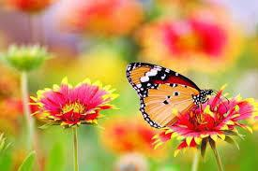
We concatenated two colored image
original image stego image

Slide 31
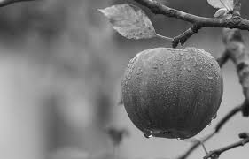
STEGANOGRAPHY FOR GREY SCALE IMAGE
We take first grey scale image: apple.jpg
# On red channel /green channel/blue channel
Peak signal noise ratio of grey scale image: 55.879
We concatenated two grey scale image
original image stego image

Slide 32
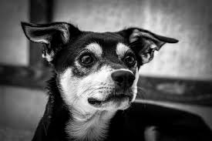
We take second grey scale image: dog.jpg
# On red channel /green channel/blue channel
Peak signal noise ratio of grey scale image: 56.1144
We concatenated two grey scale image
Original image stego image

Slide 33
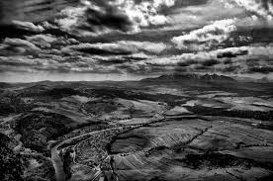
We take third grey scale image: land.jpg
#On red channel /green channel/blue channel
Peak signal noise ratio of grey scale image: 55.9874
We concatenated two grey scale image
Original image stego image

Slide 34
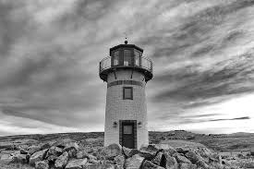
We take fourth grey scale image: tower.jpg
# On red channel /green channel/blue channel.
Peak signal noise ratio of grey scale image: 55.876
We concatenated two grey scale image
Original image stego image

Slide 35
CONCLUSION
Hiding a message with steganography methods reduces the chance of a message being detected.
In and of itself, steganography is not a good solution to secrecy, but neither is simple substitution and short block permutation for encryption. But if these methods are combined, you have much stronger encryption routines.
Like any tool, steganography is neither inherently good nor evil, it is the manner in which it is used which will determine whether it is a benefit or a detriment to our society.

Slide 36
REFERENCES
https://techdifferences.com/difference-between-steganography-and-cryptography.html
Book title: Information hiding techniques for steganagraphy and digital watermaking by Stefan Katzenbeisser and Fabien A.P. Petitcolas
https://en.wikipedia.org/wiki/Lossy_compression
https://www.geeksforgeeks.org/image-steganography-in-cryptography/
https://shodhganga.inflibnet.ac.in/bitstream/10603/92404/12/15.chapter%206.pdf
https://www.slideshare.net/SreelekshmiSree1/image-steganography-using-lsb
https://pythonprogramming.net/loading-images-python-opencv-tutorials/

